Slide 1


Agricultural Stress Index System (ASIS) based on remote sensing data Interim meeting (27 September 2012 at FAO): Some words on the computer programs Roel Van Hoolst, Herman Eerens, Antoine Royer Dominique Haesen, Lieven Bydekerke

Slide 2
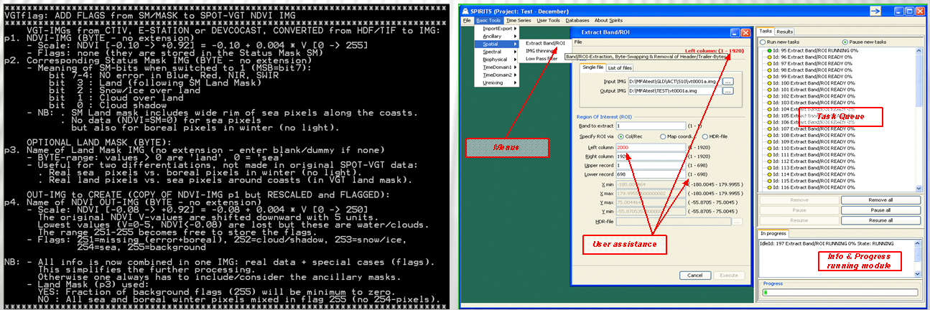
Software: Glimpse & Spirits
Glimpse
DOS C-programs
Command line
Complex chains via scripts (BAT, TCL, Python,…)
Spirits
Windows based GUI
Glimpse programs & others
Database!
Simple chains via “User Tools”

Slide 3
THREE MAIN COMPONENTS
Installation, data preparation & deliveries to FAO
Image processing, at VITO & FAO
Further analysis & visualisation tools

Slide 4
REMOTE SENSING DATA SETS
Sensor | Source | Since | Freq. | Cover | MapSys | Resol. | NDVI | BT4
METOP-AVHRR | VITO | 2007 | Dekad | Global | LonLat | 1km | + | +
NOAA-AVHRR | STAR | 1984 | Week | Global | LonLat | 16 km | + | +
SPOT-VGT | VITO | 1998 | Dekad | Global | LonLat | 1 km | + | -
NOAA-AVHRR | VITO | 1981 | Dekad | Europe | LAEA | 1km | + | +
METOP: Basic data for ASIS, to be delivered every dekad to FAO.
STAR: Only archive used (1984-2011) to simulate past data of METOP.
SPOT and NOAA-Europe: only used for some comparisons.

Slide 5
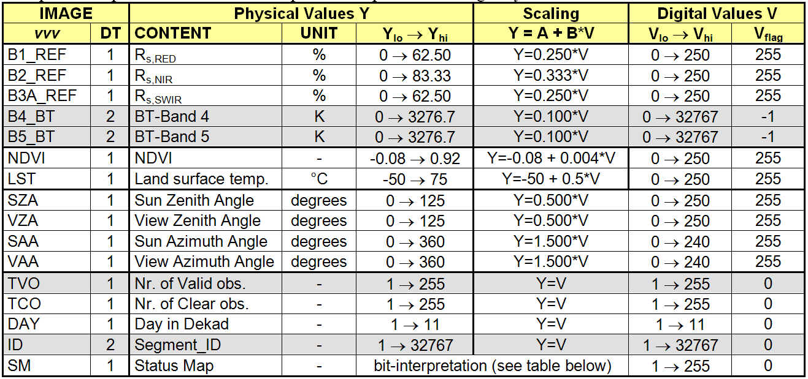
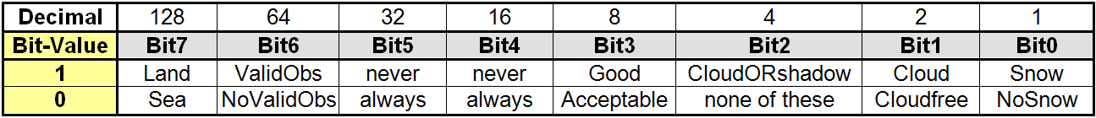
METOP-AVHRR: 10-daily syntheses (S10)
Each S10 comprises 16 images: 13 Byte-8bit, 3 Short-16bit.
Roughly: 500 MB pixels x 19 BPP ≈ 10 GB/dekad or 360 GB/year.

Slide 6
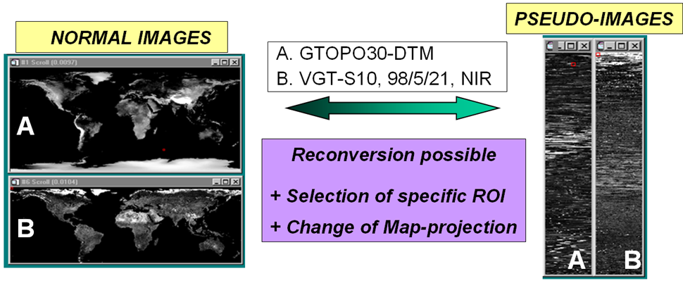
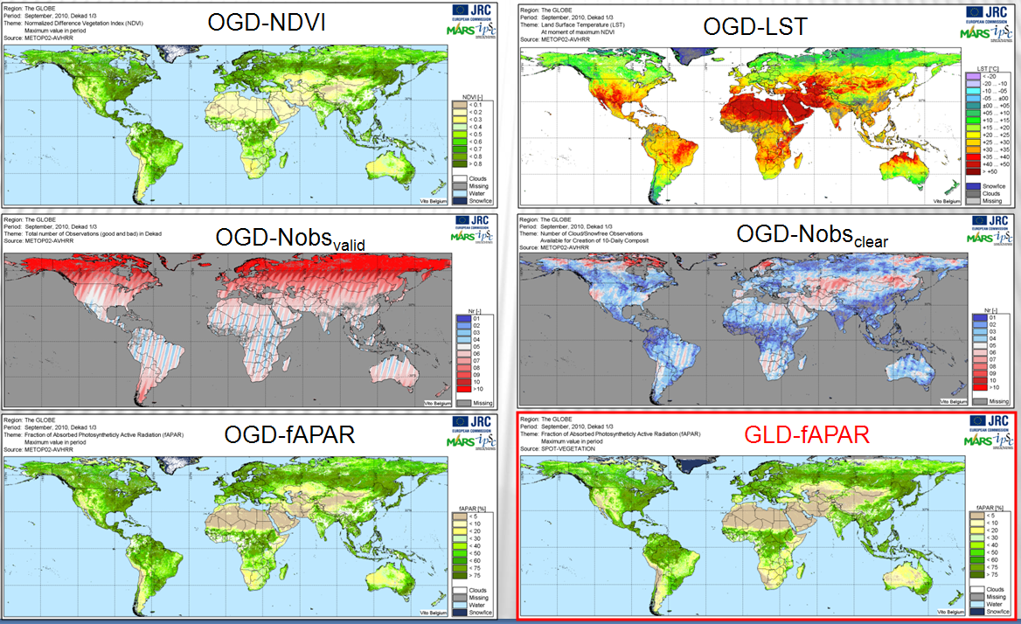
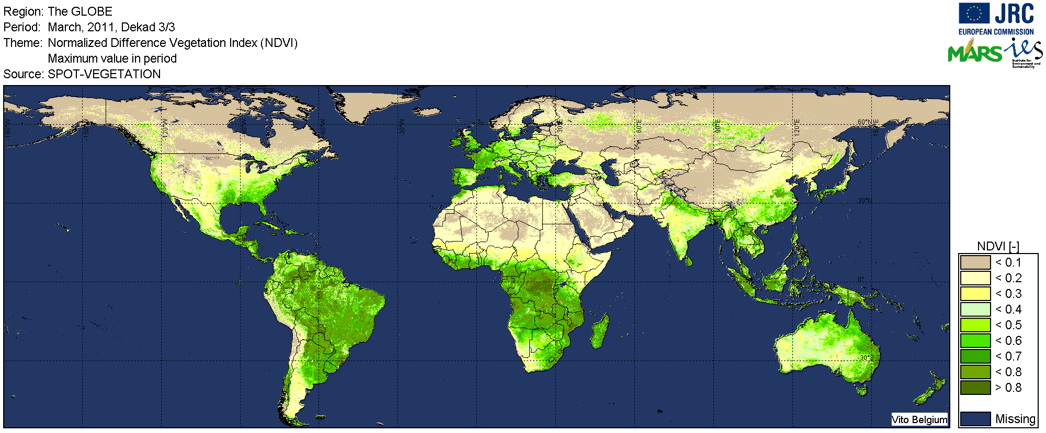
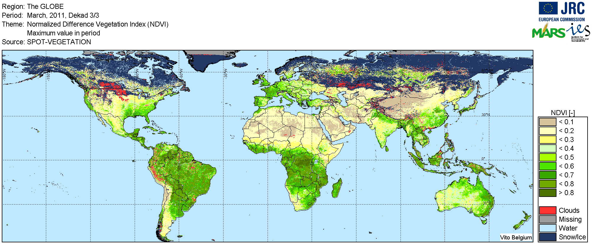
METOP-AVHRR: Pseudo-IMGs, flagged versions & thinned images (21km)
Flagged: distinction land↔sea,clear↔cloud↔snow
Original, non-flagged image
Possible approach for VITO-deliveries in operational ASIS:
Directly in global form (avoid downloads via continental tiles).
Expanded to normal format (no Pseudo-IMGs).
Only the essential data:
BT4 instead of (better) LST, because STAR does not have LST.
Only NDVI, BT4 and SM (Status Mask).
Or even only the flagged versions of NDVI and BT4 → No SM.

Slide 7
Component 1/3: Installation, data preparation & deliveries to FAO
Installation at FAO:
Hard disk of 4 to 6 TB
Standard sofware, Windows, ENVI, SPIRITS
Define final data organisation (folder structure, file names,…)
Fast FTP-connection
VITO connection would be extremely handy!
Delivery to FAO of fully processed archives, via HD:
NOAA-STAR: years 1984-2011.
METOP: years 2007-2011
Delivery to FAO of NRT basic images, via FTP:
METOP from 2012 onwards:
Global (no tiles)
Expanded to normal format (no Pseudo-IMGs).
Directly in correct format (ENVI, rescaled, adapted HDRs, …)
Only flagged NDVI and BT4?
Script for automatic downloads & addition to FAO archive

Slide 8
THREE MAIN COMPONENTS
Installation, data preparation & deliveries to FAO
Image processing, at VITO & FAO
Further analysis & visualisation tools

Slide 9
2. Image Processing Tools
Image resampling INTERPOL
Quicklook maps QL-generator
Smoothing of NDVI & BT4 SMOOTH & SMOOTHwk
Long-Term statistics per dekad LTA
Differences (VCI, TCI, VHI) DIFFER & VHI
Definition of SOS/EOS (Phenology) PHENOdat
Progress in season PHENOnow
Temporal aggregation PHENOcum
Spatial aggregation → RUM-files IMG2RUM & CLS2RUM
RUM-file → Image [RUM2IMG]
Notes:
How to monitor drought with coarse resolution remote sensing data? Basic principle = drought can be monitored as a combination of temperature and

Slide 10
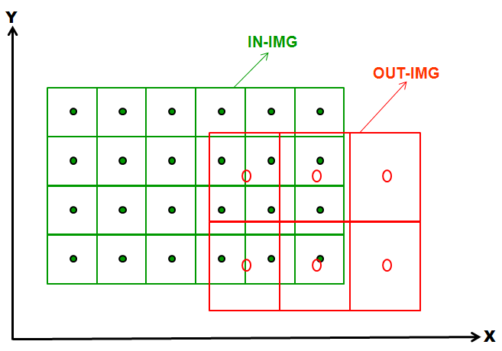
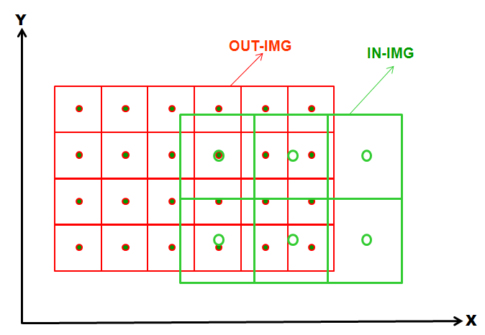
Program INTERPOL: Image resampling
Create resampled OUT-IMG, without changing the map projection.
Thinning (High to Low Resolution) Densification (Low to High Resolution)
Usage in ASIS:
Conversion METOP-1km ↔ STAR-16km.
Extraction of 1 or 16 km AFI (Area Fraction IMG) from 250m global cropmask.
Extraction of specific ROIs (Regions of Interest).
Many others…

Slide 11
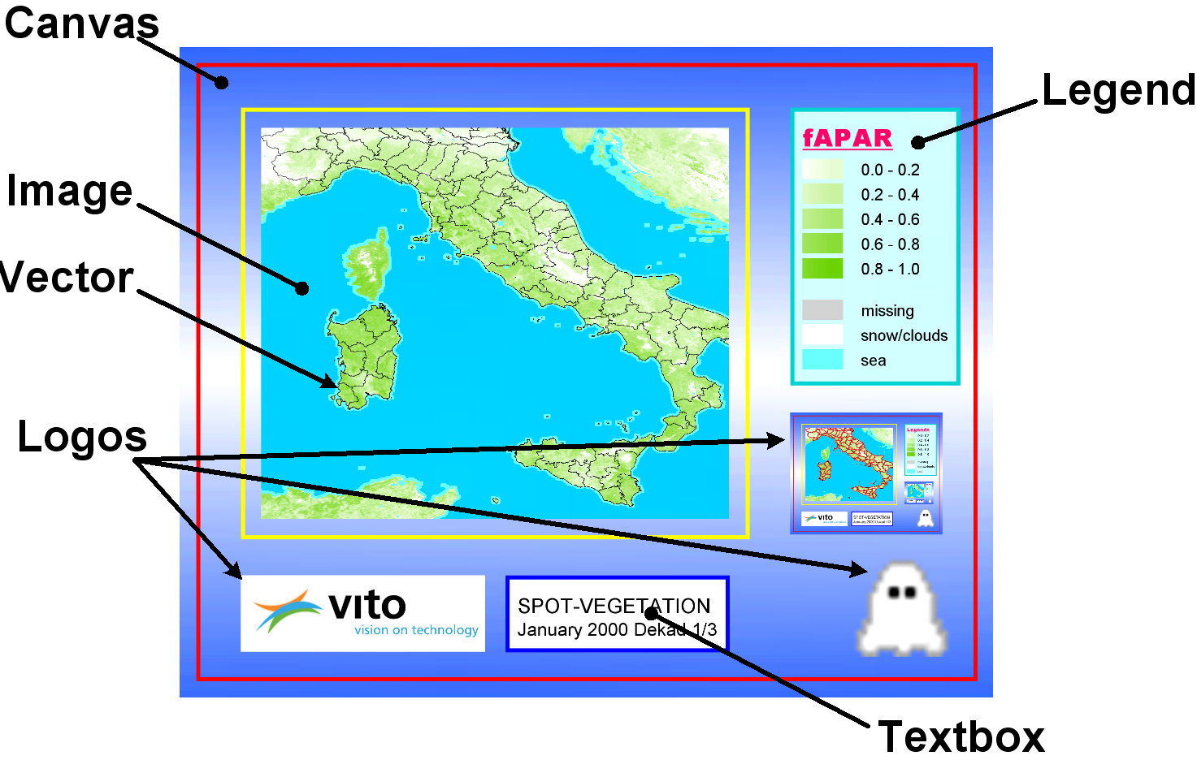
Program QL-GENERATOR: QuickLook Maps
Two steps:
SPIRITS interface to setup a “template” for the QLK-generation of a specific map ≈ region, variable, accessoires,...
Program QL-generator.exe can be used (inside or outside SPIRITS) to create Quicklooks for a complete time series of such images.

Slide 12
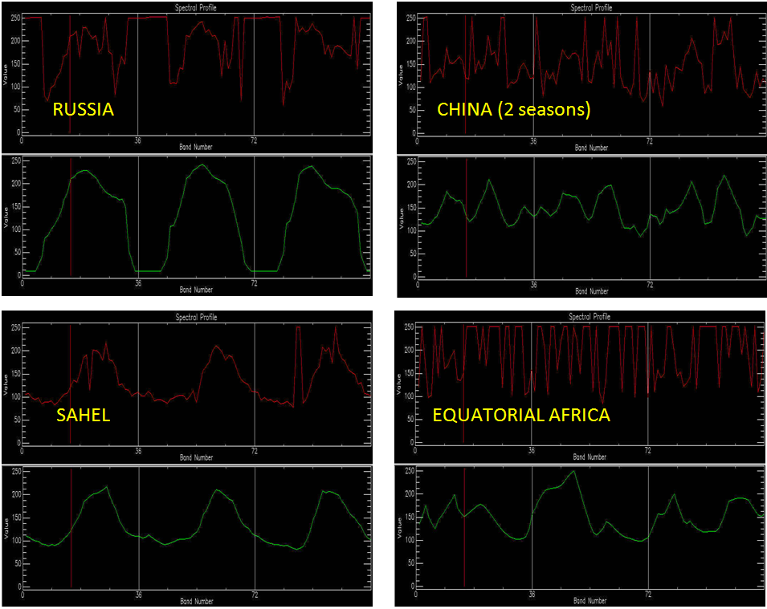
Program SMOOTH: Smoothing of NDVI & BT4 profiles
FLAGGED & CLEANED NDVI profiles from METOP 2008-2010 (108 dekads). The peaks (values > 250) are “flags”, i.e. detected clouds/snow/errors.

Slide 13
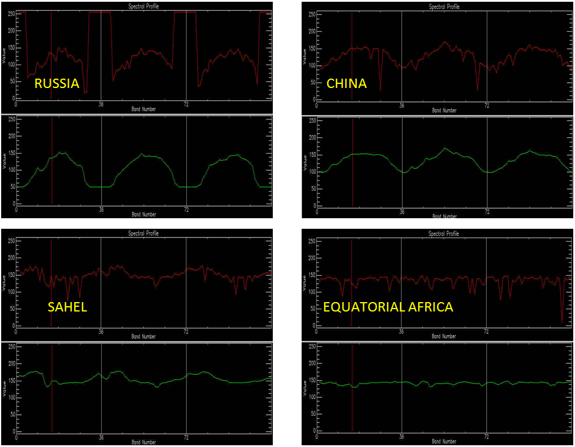
Program SMOOTH: Smoothing of NDVI & BT4 profiles
FLAGGED & CLEANED BT4 profiles from METOP 2008-2010 (108 dekads). The peaks (values > 250) are “flags”, i.e. detected clouds/snow/errors.

Slide 14
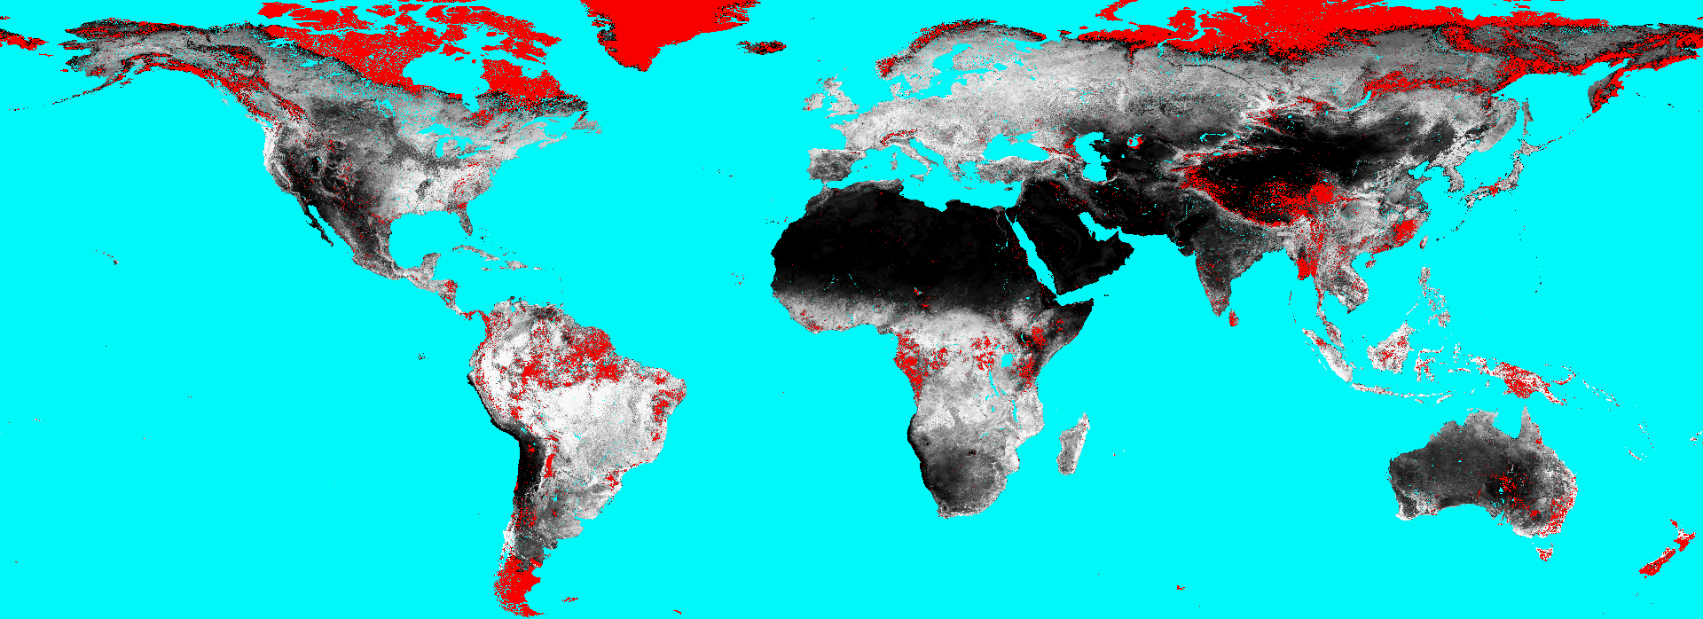
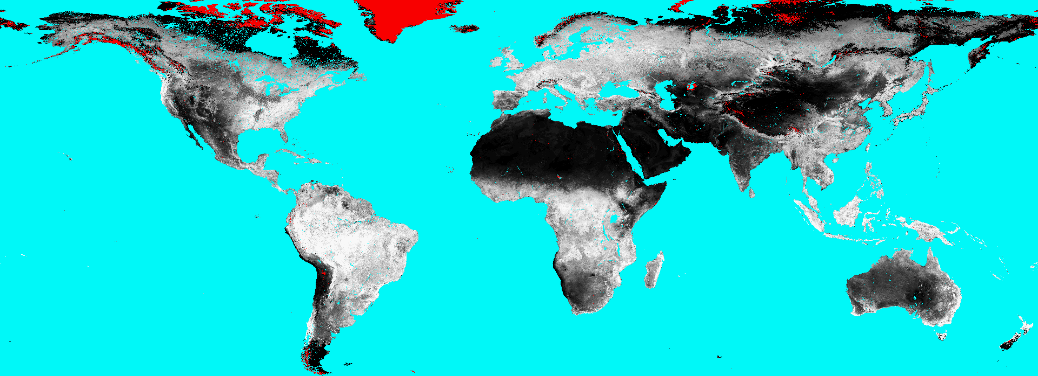
Program SMOOTH: Smoothing of NDVI & BT4 profiles
METOP-NDVI 2009, May, Dekad 3
RAW
SMOOTHED
Red pixels are missing values, found by the snow/cloud detection algorithms (SM).
SMOOTH: Removes missing values and noise. It works for NDVI and for BT4!
Indispensible step, but it complicates the NRT processing!
NB: Smoothing algorithm of STAR is unknown → Raw NDVI/BT4 used.
Same VITO smoothing applied on STAR and METOP (consistency!)
But program SMOOTH works on 10-daily inputs (↔ weekly STAR)

Slide 15
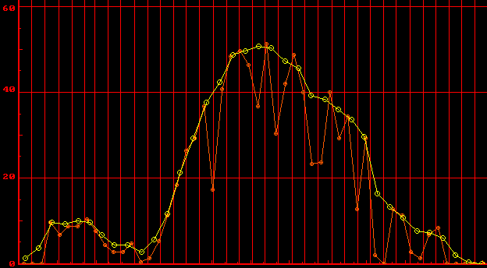
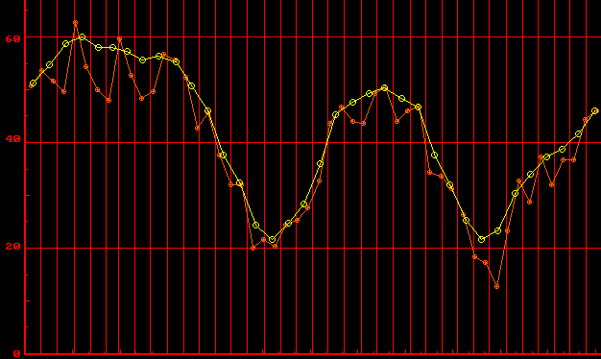
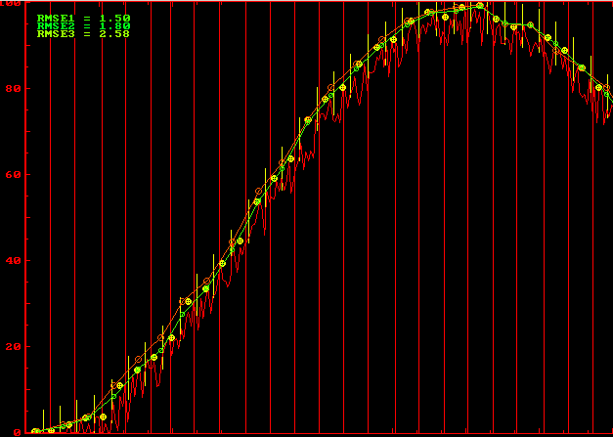
Program SMOOTHwk: Smoothing of weekly profiles
STAR-NDVI, 1998
Raw, weekly ↔ Smoothed, 10-daily
SMOOTHwk:
Weekly inputs (NOAA-STAR)
Same SWETS smoothing
Interpolation of S10 values
Centre of each dekad
First tested on simulated S1-profiles
Correct S10 values known
Best “interpolation” method
Methods to define S10-value
Interpol to dekad centre
Mean of closest week(s)
Maxval in closest week(s)

Slide 16
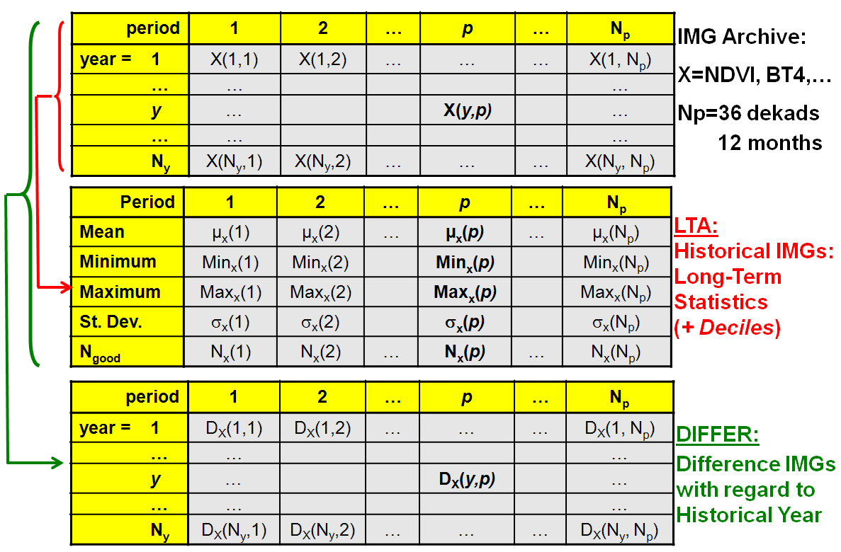
Programs LTA & DIFFER: Historical statistics & Differences
LTA: Historical statistics (Min/Max/Mean…) per dekad.
DIFFER: VCI=(NDVI-NDVI_{min})/(NDVI_{max}-NDVI_{min}), TCI=(BT4-BT4_{min})/(BT4_{max}-BT4_{min})
All applied on smoothed dekadal profiles of METOP and STAR.

Slide 17
Program VHI: Vegetation Health Index
Basic equation: VHI = w.VCI + (1-w).TCI
Input parameters:
1. Name of VCI and TCI input images (computed with DIFFER)
2. Name of VHI output image.
3. How is TCI computed?
Kogan: TCI₁=(BT4_{max} - BT4)/(BT4_{max} - BT4_{min})
DIFFER: TCI₂=(BT4 - BT4_{min})/(BT4_{max} - BT4_{min})
NB: TCI₁=1-TCI₂
4. Definition of the “weights” w:
Constant for all pixels, e.g. w=0.5 ⇒ VHI = (VCI + TCI )/2
Variable per pixel ⇒ Specify image with w-values
Notes:
W=1 ⇒ VHI=VCI, W=0 ⇒ VHI=TCI
Variable weights so far not used but can be useful later.

Slide 18
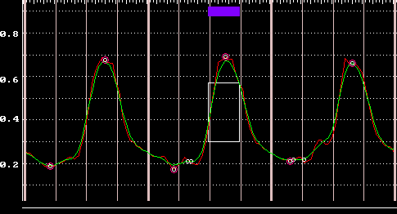
Program PHENOdat: Detect SOS/EOS for 1 or 2 cycles per year
GENERAL:
Input=3 civil years of smoothed dekadal VI-data (NDVI, fAPAR, LAI,…) → 108 IMGs.
Target= central year → Outputs relate to this civil year
Composition of the three requested input years:
BACK-proc.: All data available (e.g. for 2005, use all images of 2004-2006).
LTA: Input 36 dekads of LTA. Program duplicates them before/after.
NRT: Replace lacking/future dekads with corresponding LTA-images.
Restrict outputs to current date.
Repeat procedure → As season progresses, SOS/EOS get more reliable.
Number of seasons allowed per year: 0 (no phenology), 1 or 2.
SOS/EOS defined for each season in target year → Four basic OUT-IMGs per year (SOS1/EOS1, SOS₂/EOS₂)
SOS/EOS in dekads since start of series: 1-36=prev. year, 37-72=current, 73-108=next year.
All OUT-IMGs BYTE (8 bit):
Values 1-108: Real dekads
Values 251-255: Flags
Program is based on a set of modifiable thresholds (T₁, T₂, …).
Recently translated to fast C.

Slide 19
Program PHENOdat: Detect SOS/EOS for 1 or 2 cycles per year
ANALYSIS PER PIXEL:
First flagging of exceptions in OUT-IMGs:
All IN-values flagged → OUT-flag = SEA
Too much missing IN-values → OUT-flag = MISSING
Smooth 3-years profile with running mean filter of length 5.
Second flagging of exceptions in OUT-IMGs (land pixels without phenology)
All IN-values < T₁ → OUT-flag = DESERT
All IN-values > T₂ → OUT-flag = EQUATORIAL FOREST
Find all local maxima (seasons) & Prune them iteratively until at most 2 remain per year:
Slope of MIN-MAX (or MAX-MIN) < T₃ ⇒ Remove both
If MAX < T₄ ⇒ Remove MAX + highest MIN
If distance MAX1-MAX2 < T₅ ⇒ Remove MIN + lowest MAX
Etc.
NB: A season belongs to year n, if its MAX falls in that year.
Corresponding SOS may be in previous year, SOS in following year.
If two seasons ⇒ SOS/EOS₁ refer to FIRST maximum, SOS/EOS₂ to the LAST one.
Define SOS/EOS for the 1 or 2 seasons in central/target year:
SOS = Last dekad, between MIN and MAX, when rising profile cuts value: MIN + T₆(MAX-MIN).
EOS = First dekad, between MAX and MIN, when descending profile cuts value: MIN + T₇(MAX-MIN).
NB: For ASIS, so far: T₆=0.25 and T₇=0.25.
T₇=0.25 might compensate for the fact that we do not use EGF = EOS – 42 days.

Slide 20
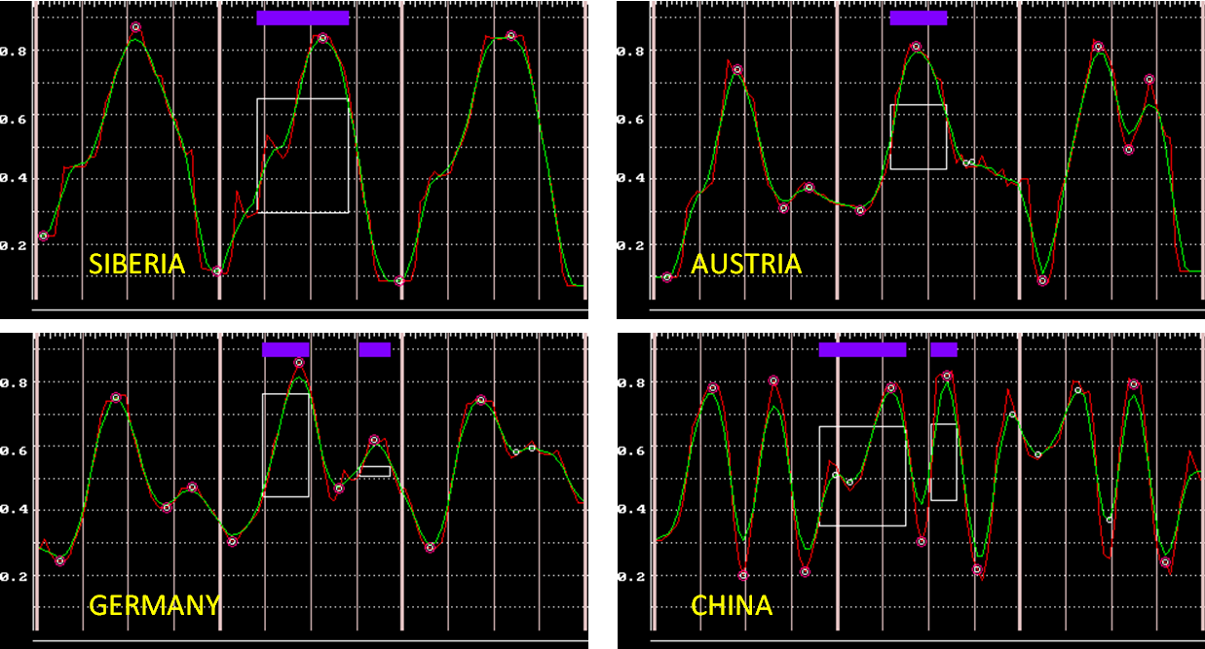
Program PHENOdat: Detect SOS/EOS for 1 or 2 cycles per year
PHENOdat examples for NDVI of SPOT-VGT of 2003-2005 (108 dekads).
Red=original profile, Green=further smoothed with running mean of length 5.
White circles=original extremes, Red circles=retained extremes.
The white squares and purple blocks indicate the periods from SOS to EOS. These are only searched for the target year 2004.

Slide 21
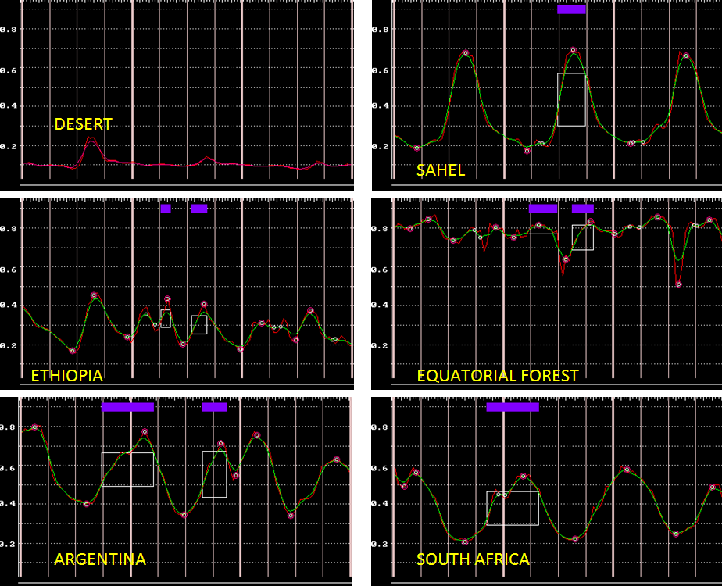

Slide 22
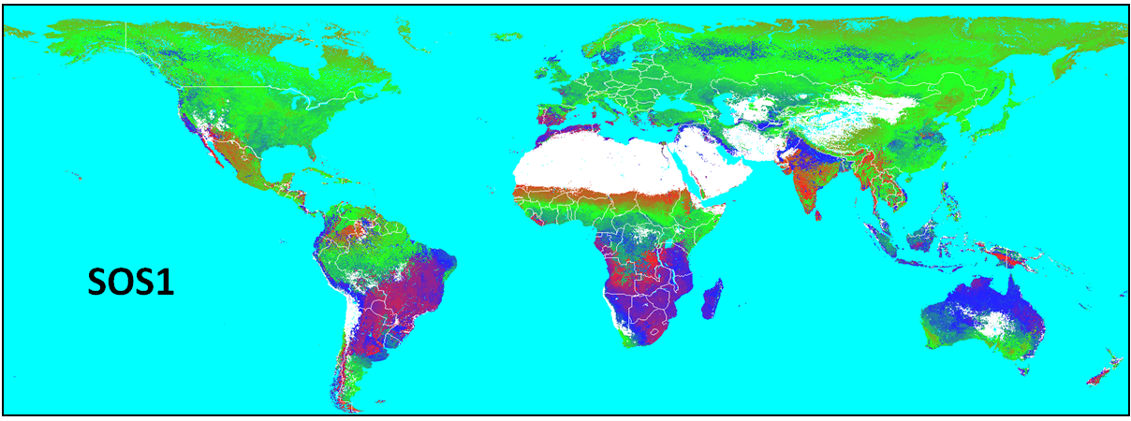
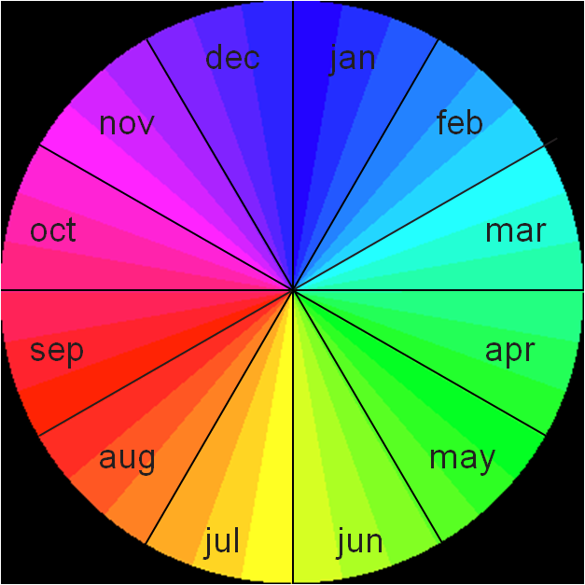
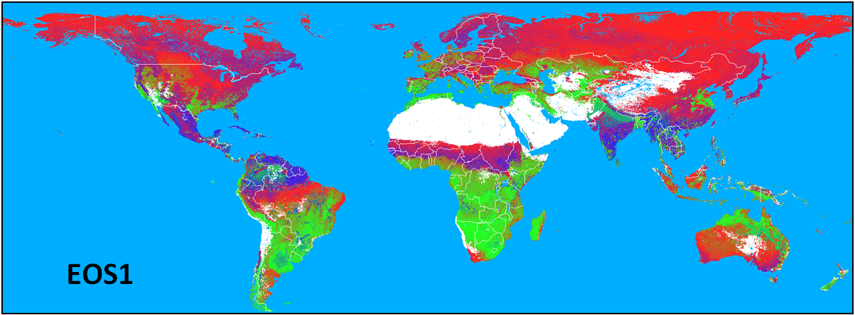
Program PHENOdat: Detect SOS/EOS for 1 or 2 cycles per year
SOS and EOS of the first season, from the long term NDVI averages of SPOT-VGT.

Slide 23
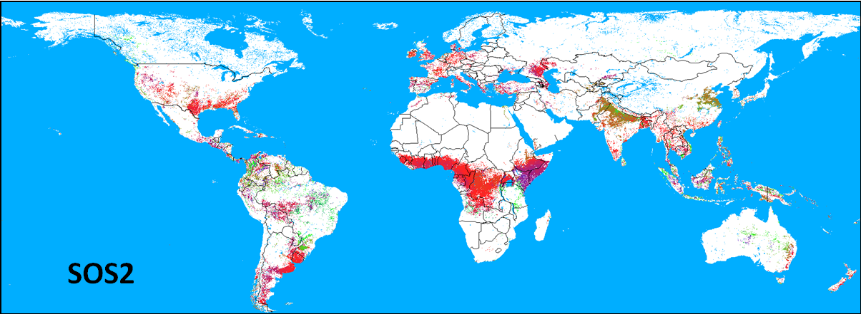
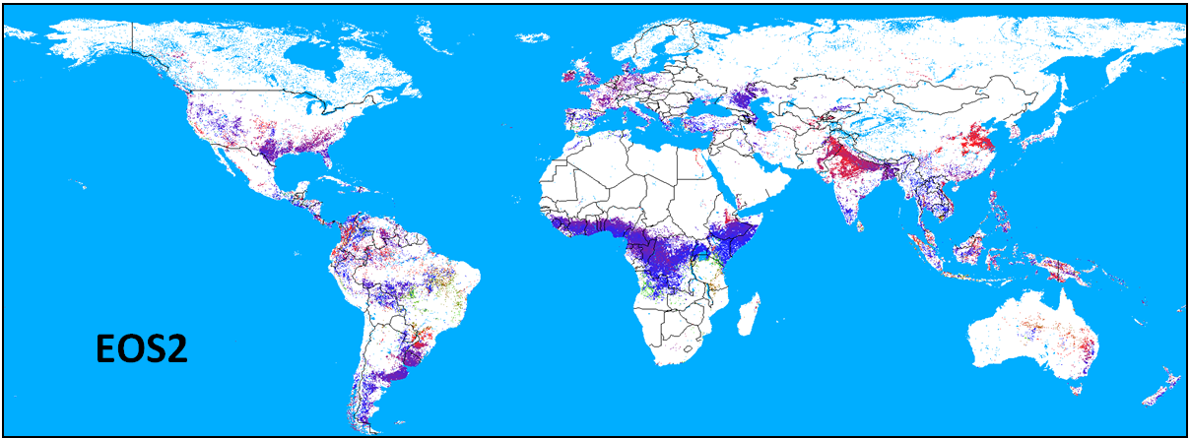
Program PHENOdat: Detect SOS/EOS for 1 or 2 cycles per year
SOS and EOS of the second season, from the long term NDVI averages of SPOT-VGT.

Slide 24
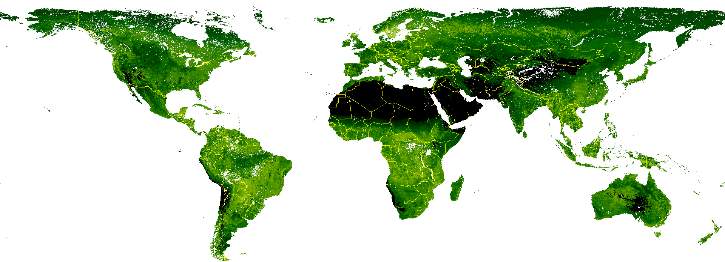
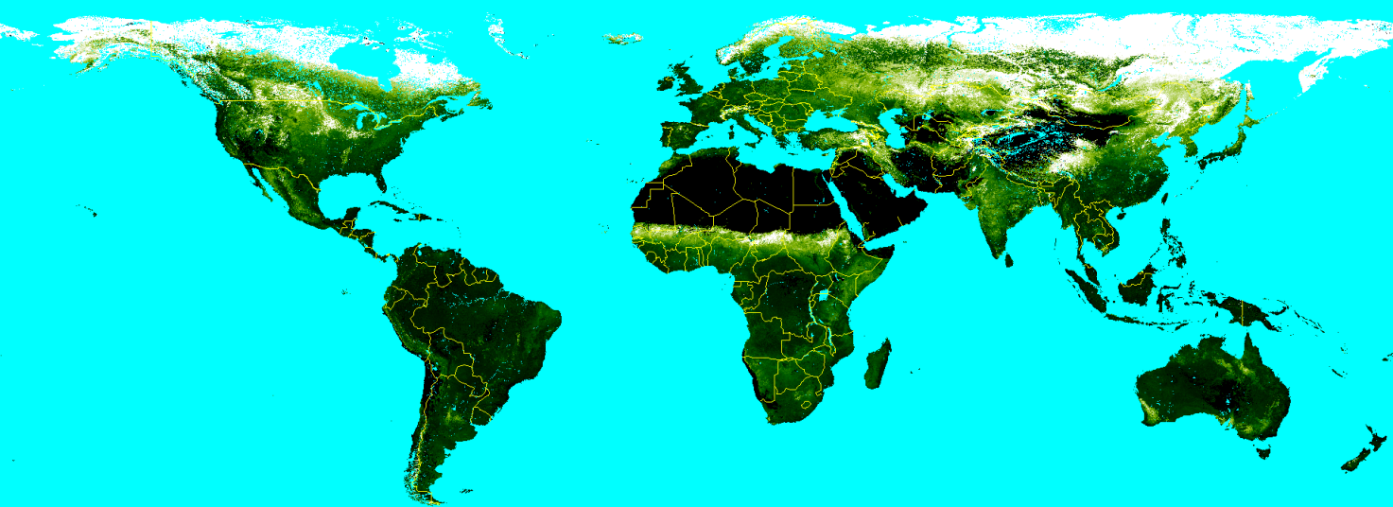
Program PHENOdat: Additional OUT-IMGs derived from SOS/EOS
Length in dekads (0-36) of the green seasons (0/1/2).
Seasonality Index SI = Ratio of mean NDVI’s in green seasons over total year.
Black=Low variation → Green → White=High variation

Slide 25
Program PHENOdat: Conclusions
Results seem OK: Comparison with other sources,
Tests on spatial & multi-annual consistency.
The African ASIS (Rojas et al.):
First derive SOS/EOS for all years, per pixel.
Then define multi-annual averages, per pixel.
Finally define mean values of SOS/EOS per administrative region.
Use these (regionally and multi-annualy) fixed SOS/EOS for all further computations (µ_{VHI},…)
But SOS/EOS are “circular variables” → Computational problems
Taking the simple (spatial/multi-annual) mean is wrong (mean of Jan/Dec=June-July).
Spatial aggregation: mode > mean.
Many standard programs, developed for normal cases, should be adapted!
Problems avoided in new global version of ASIS:
NB: Accounting for multi-annual variations would complicate matters and hamper the inter-annual comparisons, the heart of the system.
SOS/EOS defined on LTA NDVI → more stable results → No multi-annual averaging needed.
Compute essential ASIS info (µ_{VHI}, etc.) using pixel-based values of SOS/EOS.
These ordinal variables can be spatially aggregated with standard programs (IMG2RUM).
Hence, direct spatial aggregation of SOS/EOS is not needed.
Remaining questions:
Make 3 output sets: SOS/EOS₁₁ (1 season), SOS/EOS₂₁ (1st of 2 seasons) , SOS/EOS₂₂ (2nd).
Treat these groups separately, also in the database.
For ASIS, so far: T₆=0.25 and T₇=0.25. Need to apply: EGF = EOS – 42 days ?

Slide 26
Program PHENOcum: Mean/sum of VI between SOS and EOS
Recently developed in fast C. Input parameters:
1. PHENOdat results for a given year (Can also be derived from LTA)
2. Series of dekadal images to process:
- Start: must be in year before target, best from January onwards
- End: BACK: December of year after target
NRT: Actual date (no replacement of future dekads with LTA)
- Missing values in centre of series are replaced by linear interpolation
3. OUT: Two IMGs (one per season) with mean/sum of values …
- Between SOS and EOS or actual date (whichever comes first)
- OUT-values can be flagged …
. If series contains too much missing values
. If progress of season falls below a certain percentage (“too early”).
- Two types of accumulation:
. MEAN: OUT-image has same datatype as IN-IMGs
. SUM: OUT-image always “floating point” (4 bytes/pixel)
Uses in ASIS: Pixel-specific computation of means of VHI, VCI,…→ µ_{VHI}, µ_{VCI},…

Slide 27
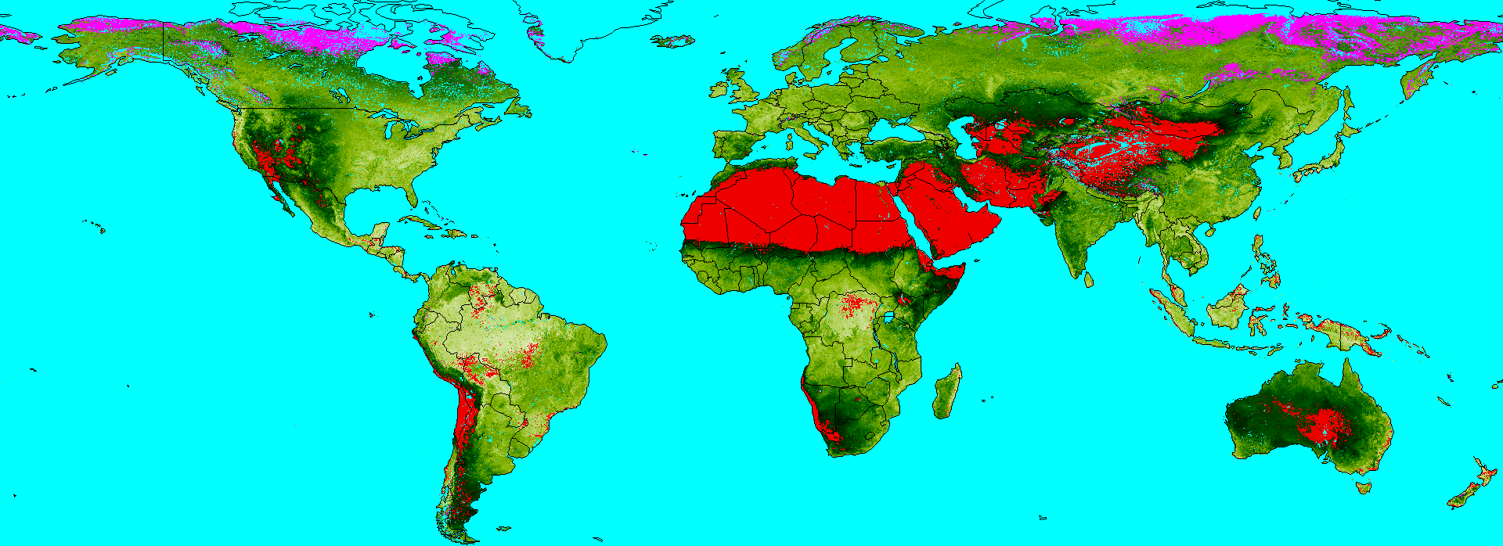
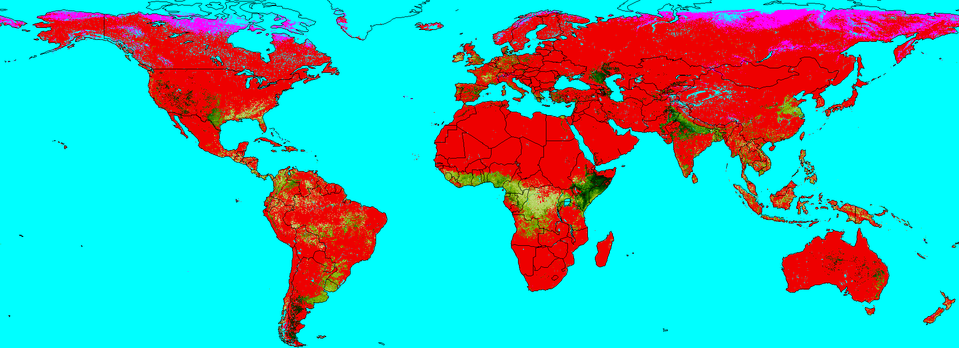
Program PHENOcum: Mean/sum of VI between SOS and EOS
IN1: SOS/EOS from NDVI-LTA of SPOT-VGT (computed by PHENOdat)
IN2: NDVI-images from January 2003 to December 2005 (target year=2004)
OUT: Mean value between SOS and EOS or June 2004.
Example of BACK-processing
Mean NDVI
No season
Too early
Missing NDVIs
Season 1
Season 2

Slide 28
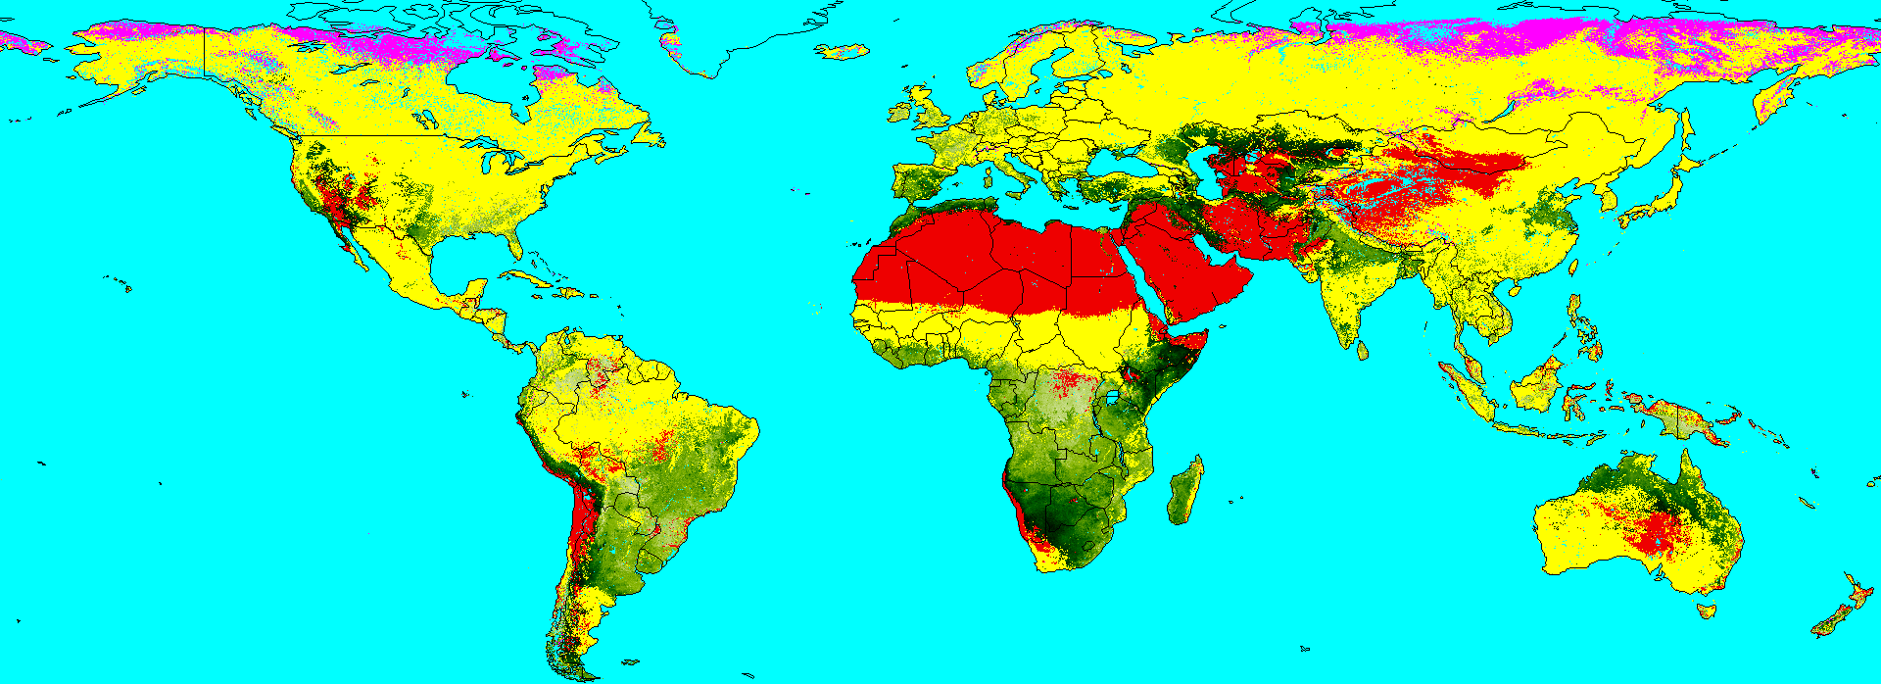
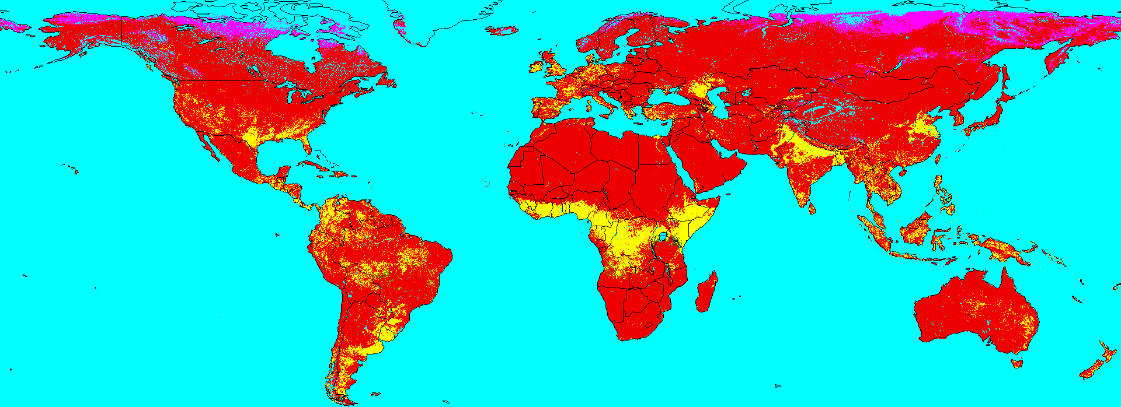
Program PHENOcum: Mean/sum of VI between SOS and EOS
IN1: SOS/EOS from NDVI-LTA of SPOT-VGT (computed by PHENOdat)
IN2: NDVI-images from January 2003 to June 2004 (target year=2004)
OUT: Mean value between SOS and EOS or June 2004.
Example of NRT-processing
Mean NDVI
No season
Too early
Missing NDVIs
Season 1
Season 2

Slide 29
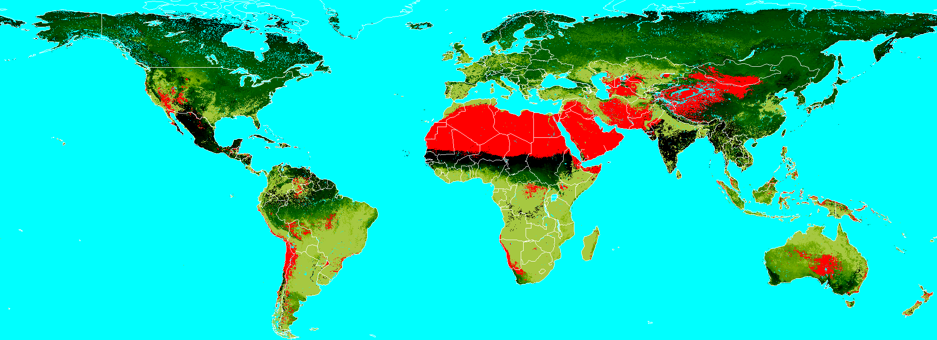
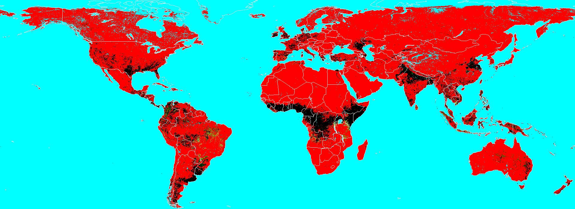
Program PHENOnow: Progress of season(s) at current date
IN1: SOS/EOS1 & SOS/EOS2 (PHENOdat). Here from NDVI-LTA of SPOT-VGT
IN2: Current date in target year. Here: end of June 2004
OUT: IMGs with relative progress (in %) of seasons 1 and 2, per pixel.
Example of NRT-processing
Season 1
0-100%
No season
Season 2

Slide 30
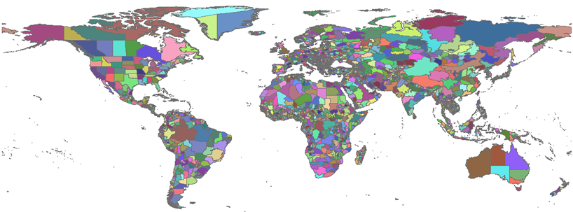
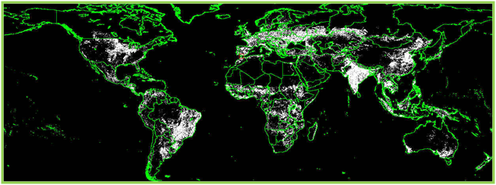
Program IMG2RUM: Spatial aggregation 1 (ordinal variables)
Images ⇒ RUM-files (Regional Unmixed Means) [⇒ Database]
RUM-FILE:
ASCII-TXT
Comma-separated values
Each line contains MEAN value of IN-IMG-values of crop pixels in a given GAUL1-region
Additional items: date, sensor-ID, variable-ID,…
IMG2RUM only works for IN-IMGs with ordinal variables
e.g. NDVI, VHI, µ_{VHI}, …
Any IN-IMG
(e.g. µ_{VHI})
Regions Map (GAUL1)
Global Crop Mask

Slide 31
Program CLS2RUM: Spatial aggregation 2 (categorical var’s)
Images ⇒ RUM-files (Regional Unmixed Means) [⇒ Database]
OUTPUT:
Same type of RUM-files as for IMG2RUM
Instead of regional MEANS, the file contains regional FREQUENCIES of a given “event”.
If IN-IMG = classification → Event = frequency of a given class
If IN-IMG = ordinal → Event = frequency of pixels with values in a given range. E.g.: µ_{VHI} < 35%
Program to be improved.
Any IN-IMG
Regions Map (GAUL1)
Global Crop Mask

Slide 32
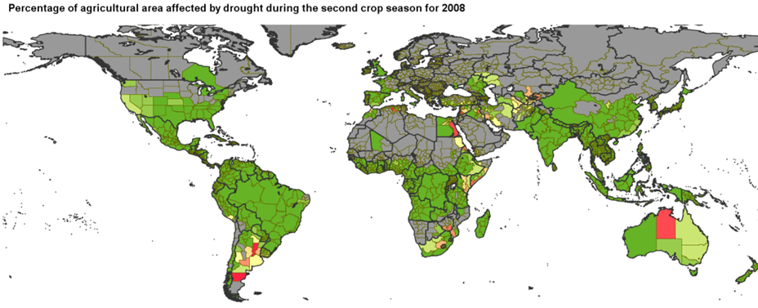
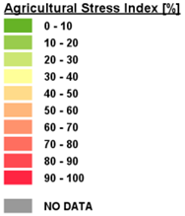
Program RUM2IMG: Reconvert RUM-values to IMG format
Any RUM-file
Regions Map (GAUL1)
Program still to be developed. Today: only temporary work-arounds (BASIC)
Needed to visualize the RUM-values via QL-generator.

Slide 33
2. Image Processing Tools (review)
Image resampling INTERPOL
Quicklook maps QL-generator
Smoothing of NDVI & BT4 SMOOTH & SMOOTHwk
Long-Term statistics per dekad LTA
Differences (VCI, TCI, VHI) DIFFER & VHI
Definition of SOS/EOS (Phenology) PHENOdat
Progress in season PHENOnow
Temporal aggregation PHENOcum
Spatial aggregation → RUM-files IMG2RUM & CLS2RUM
RUM-file → Image [RUM2IMG]
Notes:
How to monitor drought with coarse resolution remote sensing data? Basic principle = drought can be monitored as a combination of temperature and

Slide 34
Component 2/3: Image processing, at VITO & FAO
Setup of the processing chains:
Development & testing of all scripts (BAT, Python) to perform the requested tasks, using the above basic tools.
Transfer to FAO.
Activated via SCHEDULER to run automatically in batch.
Every dekad: Smooth & reprocess last six dekads → Recompute …
Images of VCI, TCI, VHI, µ_{VHI}, Progress,…
Quicklook maps
RUM-files
Every x years → Recompute …
Long-term statistics of NDVI and BT4 (program LTA)
SOS/EOS from updated NDVI-LTA (program PHENOdat)
All derived information for complete archive:
Years 1984 → Present
VCI, TCI, VHI, µ_{VHI}
Images, quicklooks, RUM-files

Slide 35
THREE MAIN COMPONENTS
Installation, data preparation & deliveries to FAO
Image processing, at VITO & FAO
Further analysis & visualisation tools
Web Viewer and/or Spirits?
Spirits
Methodological variants & Local applications

Slide 36
Further analysis via Web Viewer and/or Spirits?
We started with SPIRITS for the following reasons:
Core of the ASIS is the RUM-database, not the imagery.
Spirits provides all requested DB management facilities.
Also graphical analysis tools.
Perfect in development stage:
We’re experts in Spirits, work daily with it.
Adaptations are readily introduced by Dominique Haesen.
Different approaches can quickly be tested with Spirits.
Web Viewer?
For the moment too vague, clear specifications are still lacking.
At VITO: to be outsourced to IT-specialist → risk of losing controI!
Not mentioned in the contact (LoA)
Proposal:
First continue with Spirits until all further requirements are clear.
Then maybe think about the role of a Web Viewer.
Recent: a simple demo version can be developed!

Slide 37
SPIRITS: RUM-Database
Architecture of the RUM database in SPIRITS. In advance a number of ancillary tables have to be filled with the specifications of the allowed regions, classes, sensors, variables, unmixing methods, periodicities and types (ACTUAL or HISTORICAL, for the latter there is only one “year”). For the regions and classes, different sets can be specified. A “series” is defined as the combination of all these ancillary elements, for instance the actual, dekadal METOP-NDVI of cropland in the Belgian province of Antwerp, unmixed with UMmet=2. The core of the database is formed by tables RUM_HEADERS and RUM_VALUES. RUM_HEADERS contains the ID (PK=RUM_KEY) of all such “series” ever encountered. RUM_VALUES contains their actual values (mean, standard deviation, relative areas RA1/RA2) for each subsequent date.

Slide 38
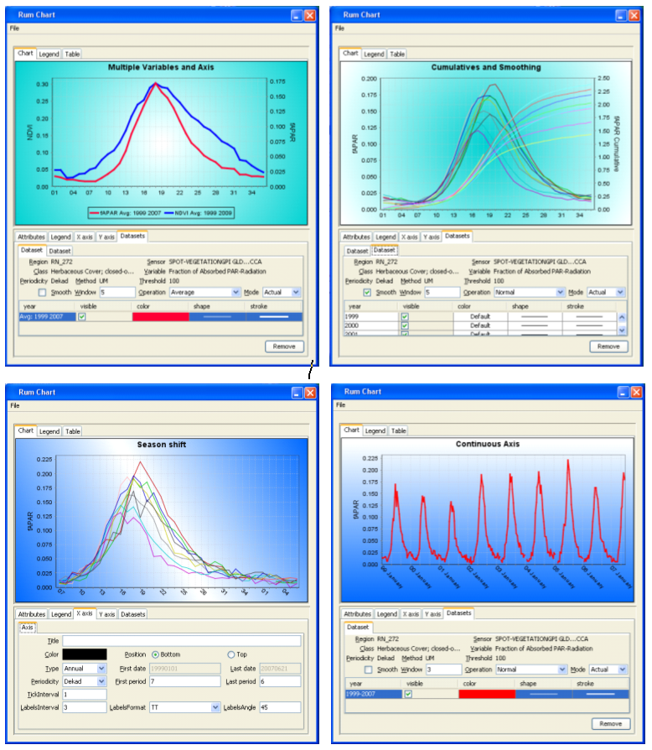
SPIRITS: RUM-Database
& Graphical Analyses
APPROACH:
All RUM-values stored in DB
3600 GAUL-regions
All variables: NDVI, BT4, VCI, TCI, VHI, µ_{VHI}, progress, ASI,…
Separate for pixels with ½ seasons
Etc.
SPIRITS:
DB can be > 10 GB
Still very fast
Wide range of graphical analyses

Slide 39
Methodological Variants & Local Applications
Methodological variants:
All parameters of the current approach can be modified, either via “settings-files” or via the scripts. Some examples:
Specifications of SMOOTH, PHENOdat, etc.
The weights w used in VHI=w.VCI+(1-w).TCI.
All accessories for the quicklooks: vectors, logos, palettes,…
Crop mask and regions map used for the RUM-computations.
Definition of ASI: % of crop pixels with µ_{VHI} < T (now: T=35%).
Even more fundamental changes can be introduced:
Replacement of VCI/TCI by standard scores.
Give more weight to METOP in LTA by skipping early NOAA years
Local applications – Proposal:
At the lower level, the system will always be run on a global scale.
Dedicated scripts can be prepared to extract all requested image data for a specific ROI (Region of Interest).
For this ROI, only the QuickLooks must be re-generated.
The RUM-values can still be inspected via the global database.

Slide 40
ASIS-Software: Conclusions
Installation, data preparation & deliveries to FAO
Basic approach developed.
Most data (STAR, METOP) prepared at VITO.
Image processing, at VITO & FAO
Most basic tools now available via Glimpse.
Further analysis & visualisation tools
Spirits: most analysis tools available.
Spirits: Glimpse ASIS-programs still to be included.
Web Viewer: a demo will be provided.

Slide 41
ASIS-Software: TODOs & Planning Before end of …
Agreement on general approach. SEP
VITO-preparations: OCT
Define conventions: folder organisation, file names, ...
Cleanup & compute lacking data.
Send archives (STAR, METOP) to FAO via HD.
FAO: Disk system & VITO-permission (?) OCT
Development & testing (at VITO and FAO) of scripts for: NOV
NRT delivery/acquisition of new METOP data.
NRT processing of new METOP data.
Periodic update of archives (LTA, PHENOdat,...).
Treatment of specific ROIs.
Analysis & visualisation tools:
Spirits: develop all requested QL-templates… NOV
Web Viewer: devlop demo & define overall specs. DEC
Software improvements, in parallel: DEC
Glimpse: Program RUM2IMG & Overall documentation
Spirits: Include all ASIS-modules & Help functionality
Final document & Training at FAO. JAN

Slide 42
Agricultural Stress Index System (ASIS) based on remote sensing data Interim meeting (27 September 2012 at FAO): Some words on the computer programs Roel Van Hoolst, Herman Eerens, Antoine Royer Dominique Haesen, Lieven Bydekerke

